Slide 1
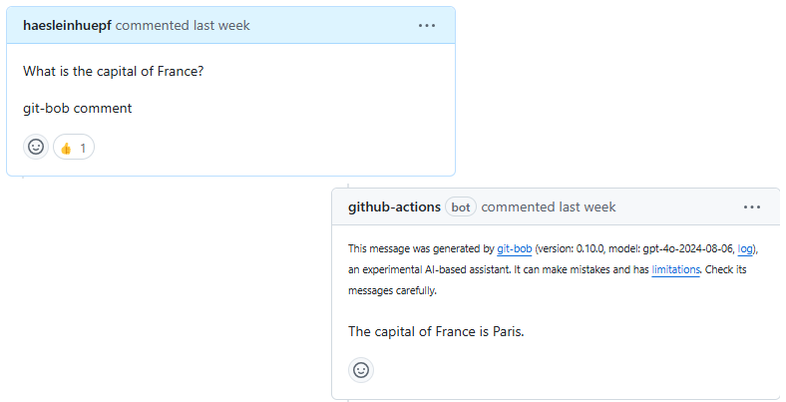
Training Computational Skills in the Age of AI
Exploring modern tools and best practices for scientific computing and software development.

Slide 2

Version Control & Git
- Essential for tracking changes and collaboration
- Branching strategies for feature development
- Pull requests and code review practices
- Conflict resolution and merging
- Git commands and workflows

Slide 3
Modern Scientific Platforms
- GitHub: Collaborative development and version control
- Zenodo: Research output archival and DOI generation
- Huggingface: AI model sharing and deployment
- Integration between platforms for seamless workflows

Slide 4
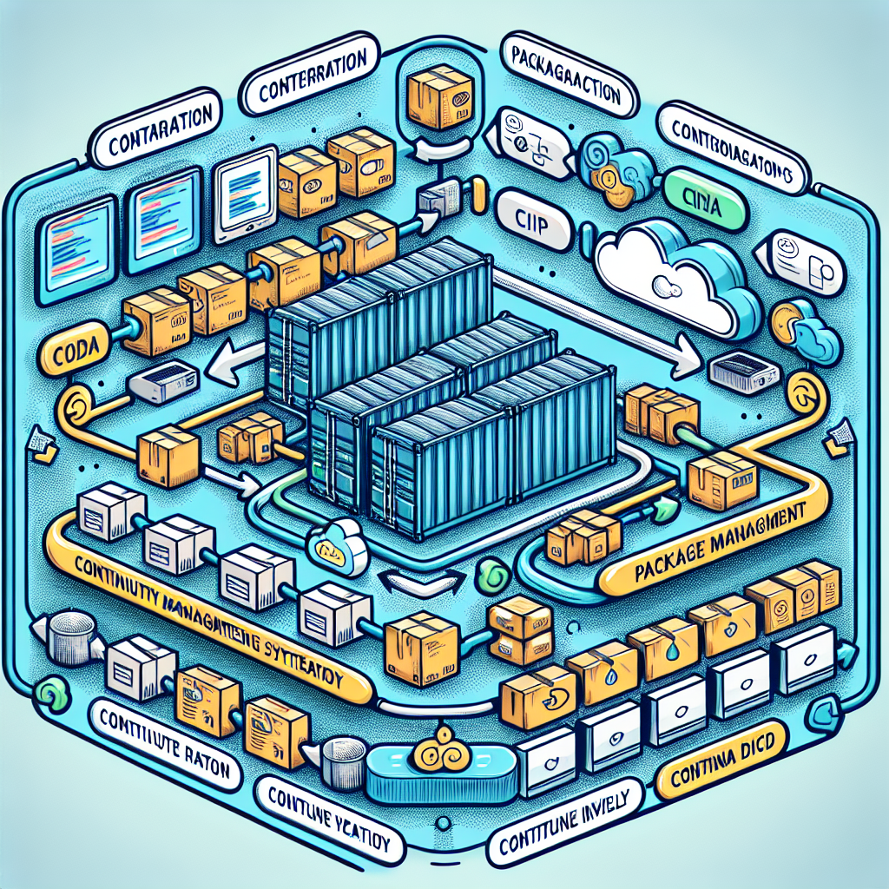
Development Infrastructure
- Containerization (Docker, Singularity)
- Continuous Integration/Deployment (CI/CD)
- Package management for reproducibility
- Environment isolation and portability

Slide 5
Package Management: Conda vs Pip
- Conda: Environment management, multi-language support
* Binary package distribution
* Platform-specific builds
- Pip: Python-specific package installer
* Installs from PyPI
* Lighter weight, faster installation

Slide 6
Code Quality & Testing
- Unit testing frameworks (pytest)
- Code coverage metrics
- Style guidelines (PEP8)
- Linting tools (flake8, black)
- Automated testing in CI pipelines

Slide 7
Documentation & Licensing
- FAIR principles: Findable, Accessible, Interoperable, Reusable
- Documentation tools (Sphinx, ReadTheDocs)
- API documentation best practices
- Open-source licenses (MIT, GPL, Apache)
- Citation guidelines

Slide 8
Jupyter Books
- Combining narrative text and executable code
- Publishing interactive documentation
- Version control integration
- Automated building and deployment

Slide 9
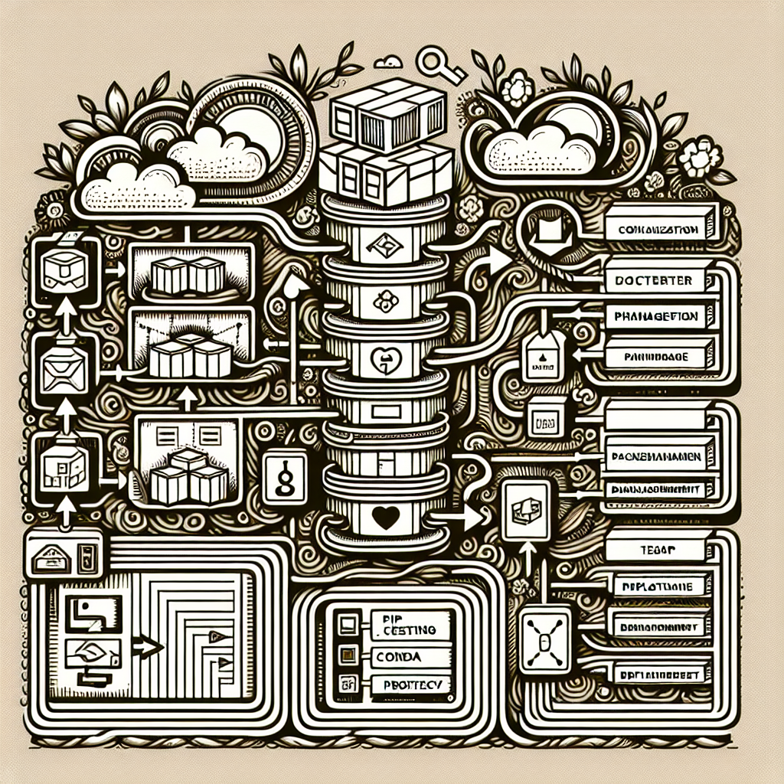
AI Tools: Common Pitfalls
- Code hallucinations and non-existing functions
- Overreliance on AI-generated solutions
- Security risks in generated code
- Licensing concerns

Slide 10
Good Scientific Practice with AI
- Document AI tool usage in publications
- Verify and test AI-generated code
- Maintain intellectual ownership
- Regular code reviews for AI contributions
- Balance between AI assistance and original work

